Slide 1
Part Two:
Optimizing Pintools
Robert Cohn
Intel

Slide 2
Reducing Instrumentation Overhead
Total Overhead = Pin Overhead + Pintool Overhead
~5% for SPECfp and ~50% for SPECint
Pin team’s job is to minimize this
Usually much larger than pin overhead
Pintool writers can help minimize this!

Slide 3
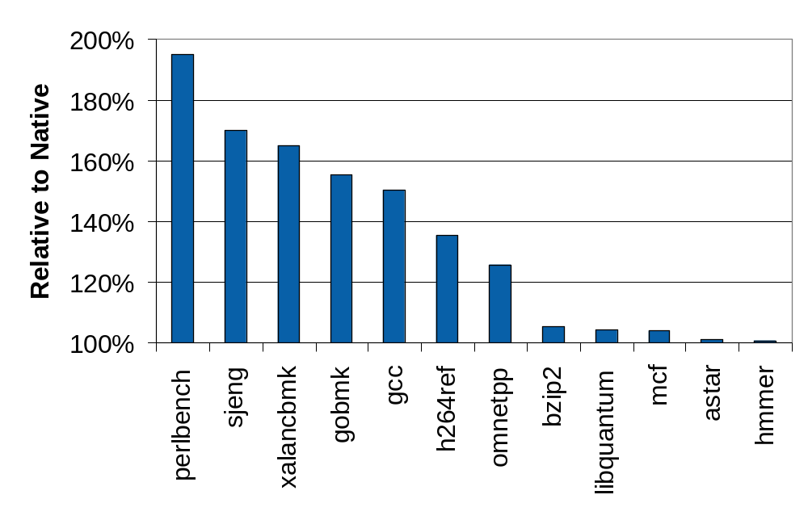
Pin Overhead
SPEC Integer 2006

Slide 4
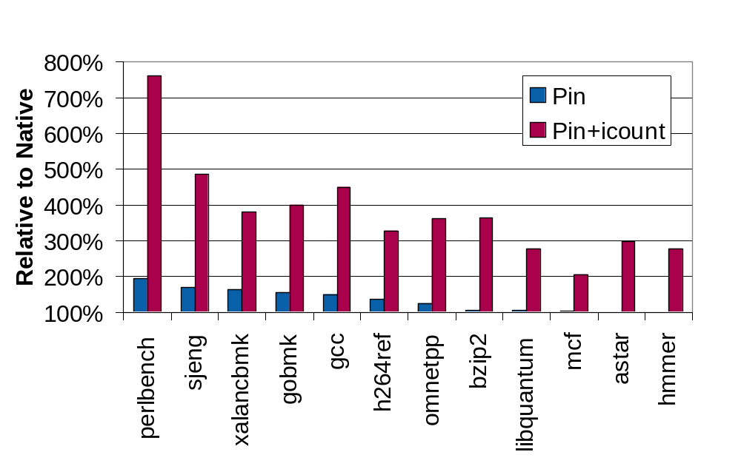
Adding User Instrumentation

Slide 5
Reducing the Pintool’s Overhead
Pintool’s Overhead
Instrumentation Routines Overhead
Analysis Routines Overhead
+
Frequency of calling an Analysis Routine
Work required in the Analysis Routine
x
Work required for transiting to Analysis Routine
Work done inside Analysis Routine

Slide 6
Reducing Work in Analysis Routines
Key: Shift computation from analysis routines to instrumentation routines whenever possible
This usually has the largest speedup

Slide 7
Edge Counting: a Slower Version
...
void docount2(ADDRINT src, ADDRINT dst, INT32 taken)
{
COUNTER *pedg = Lookup(src, dst);
pedg->count += taken;
}
void Instruction(INS ins, void *v) {
if (INS_IsBranchOrCall(ins))
{
INS_InsertCall(ins, IPOINT_BEFORE, (AFUNPTR)docount2,
IARG_INST_PTR, IARG_BRANCH_TARGET_ADDR,
IARG_BRANCH_TAKEN, IARG_END);
}
}
...

Slide 8
Edge Counting: a Faster Version
void docount(COUNTER* pedge, INT32 taken) {
pedg->count += taken;
}
void docount2(ADDRINT src, ADDRINT dst, INT32 taken) {
COUNTER *pedg = Lookup(src, dst);
pedg->count += taken;
}
void Instruction(INS ins, void *v) {
if (INS_IsDirectBranchOrCall(ins)) {
COUNTER *pedg = Lookup(INS_Address(ins),
INS_DirectBranchOrCallTargetAddress(ins));
INS_InsertCall(ins, IPOINT_BEFORE, (AFUNPTR) docount,
IARG_ADDRINT, pedg, IARG_BRANCH_TAKEN, IARG_END);
} else
INS_InsertCall(ins, IPOINT_BEFORE, (AFUNPTR) docount2,
IARG_INST_PTR, IARG_BRANCH_TARGET_ADDR,
IARG_BRANCH_TAKEN, IARG_END);
}
…

Slide 9
Analysis Routines: Reduce Call Frequency
Key: Instrument at the largest granularity whenever possible
    Instead of inserting one call per instruction
    Insert one call per basic block or trace

Slide 10
Slower Instruction Counting
counter++;
sub $0xff, %edx
cmp %esi, %edx
jle <L1>
mov $0x1, %edi
add $0x10, %eax
counter++;
counter++;
counter++;
counter++;

Slide 11
Faster Instruction Counting
Counting at BBL level
Counting at Trace level
counter += 3
sub $0xff, %edx
cmp %esi, %edx
jle <L1>
mov $0x1, %edi
add $0x10, %eax
sub $0xff, %edx
cmp %esi, %edx
jle <L1>
mov $0x1, %edi
add $0x10, %eax
counter += 5
counter += 2
counter+=3
L1

Slide 12
Reducing Work for Analysis Transitions
Reduce number of arguments to analysis routines
  Inline analysis routines
  Pass arguments in registers
  Instrumentation scheduling

Slide 13
Reduce Number of Arguments
Eliminate arguments only used for debugging
Instead of passing TRUE/FALSE, create 2 analysis functions
    Instead of inserting a call to:
      Analysis(BOOL val)
    Insert a call to one of these:
      AnalysisTrue()
      AnalysisFalse()
  IARG_CONTEXT is very expensive (> 10 arguments)

Slide 14
Inlining
Not-inlinable
Inlinable
int docount1(int i) {
if (i == 1000)
x[i]++;
return x[i];
}
int docount0(int i) {
x[i]++
return x[i];
}
Not-inlinable
Not-inlinable
int docount2(int i) {
x[i]++;
printf(“%d”, i);
return x[i];
}
void docount3() {
for(i=0;i<100;i++)
x[i]++;
}
Pin will inline analysis functions into application code
Notes:
Embed analysis routines directly into the application
Avoid transiting through “bridges”
Current limitation:
Only straight-line code can be inlined

Slide 15
Inlining
Inlining decisions are recorded in pin.log with log_inline
pin –xyzzy –mesgon log_inline –t mytool – app
Analysis function at 0x2a9651854c CAN be inlined
Analysis function at 0x2a9651858a is not inlinable because the last instruction
of the first bbl fetched is not a ret instruction. The first bbl fetched:
================================================================================
bbl[5:UNKN]: [p: ? ,n: ? ] [____] rtn[ ? ]
--------------------------------------------------------------------------------
31 0x000000000 0x0000002a9651858a push rbp
32 0x000000000 0x0000002a9651858b mov rbp, rsp
33 0x000000000 0x0000002a9651858e mov rax, qword ptr [rip+0x3ce2b3]
34 0x000000000 0x0000002a96518595 inc dword ptr [rax]
35 0x000000000 0x0000002a96518597 mov rax, qword ptr [rip+0x3ce2aa]
36 0x000000000 0x0000002a9651859e cmp dword ptr [rax], 0xf4240
37 0x000000000 0x0000002a965185a4 jnz 0x11

Slide 16
Passing Arguments in Registers
32 bit platforms pass arguments on stack
Passing arguments in registers helps small inlined functions
VOID PIN_FAST_ANALYSIS_CALL docount(ADDRINT c) { icount += c; }
BBL_InsertCall(bbl, IPOINT_ANYWHERE, AFUNPTR(docount), IARG_FAST_ANALYSIS_CALL, IARG_UINT32, BBL_NumIns(bbl), IARG_END);

Slide 17
Conditional Inlining
Inline a common scenario where the analysis routine has a single “if-then”
  The “If” part is always executed
  The “then” part is rarely executed
  Useful cases:
    “If” can be inlined, “Then” is not
    “If” has small number of arguments, “then” has many arguments (or IARG_CONTEXT)
Pintool writer breaks analysis routine into two:
  INS_InsertIfCall (ins, …, (AFUNPTR)doif, …)
  INS_InsertThenCall (ins, …, (AFUNPTR)dothen, …)

Slide 18
IP-Sampling (a Slower Version)
const INT32 N = 10000; const INT32 M = 5000;
INT32 icount = N;
VOID IpSample(VOID* ip) {
--icount;
if (icount == 0) {
fprintf(trace, “%p\n”, ip);
icount = N + rand()%M; //icount is between <N, N+M>
}
}
VOID Instruction(INS ins, VOID *v) {
INS_InsertCall(ins, IPOINT_BEFORE, (AFUNPTR)IpSample,
IARG_INST_PTR, IARG_END);
}

Slide 19
IP-Sampling (a Faster Version)
INT32 CountDown() {
--icount;
return (icount==0);
}
VOID PrintIp(VOID *ip) {
fprintf(trace, “%p\n”, ip);
icount = N + rand()%M; //icount is between <N, N+M>
}
inlined
not inlined
VOID Instruction(INS ins, VOID *v) {
// CountDown() is always called before an inst is executed
INS_InsertIfCall(ins, IPOINT_BEFORE, (AFUNPTR)CountDown,
IARG_END);
// PrintIp() is called only if the last call to CountDown()
// returns a non-zero value
INS_InsertThenCall(ins, IPOINT_BEFORE, (AFUNPTR)PrintIp, IARG_INST_PTR, IARG_END);
}

Slide 20
Instrumentation Scheduling
If an instrumentation can be inserted anywhere in a basic block:
  Let Pin know via IPOINT_ANYWHERE
  Pin will find the best point to insert the instrumentation to minimize register spilling

Slide 21
ManualExamples/inscount1.cpp
#include <stdio.h>
#include "pin.H“
UINT64 icount = 0;
void docount(INT32 c) { icount += c; }
void Trace(TRACE trace, void *v) {
for (BBL bbl = TRACE_BblHead(trace);
BBL_Valid(bbl); bbl = BBL_Next(bbl)) {
BBL_InsertCall(bbl,IPOINT_ANYWHERE,(AFUNPTR)docount,
IARG_UINT32, BBL_NumIns(bbl), IARG_END);
}
}
void Fini(INT32 code, void *v) {
fprintf(stderr, "Count %lld\n", icount);
}
int main(int argc, char * argv[]) {
PIN_Init(argc, argv);
TRACE_AddInstrumentFunction(Trace, 0);
PIN_AddFiniFunction(Fini, 0);
PIN_StartProgram();
return 0;
}
analysis routine
instrumentation routine

Slide 22
Optimizing Your Pintools - Summary
Baseline Pin has fairly low overhead (~5-20%)
Adding instrumentation can increase overhead significantly, but you can help!
Move work from analysis to instrumentation routines
Explore larger granularity instrumentation
Explore conditional instrumentation
Understand when Pin can inline instrumentation

Slide 23
Part Three:
Analyzing Parallel Programs
Robert Cohn

Slide 24
ManualExamples/inscount0.cpp
#include <iostream>
#include "pin.h"
UINT64 icount = 0;
void docount() { icount++; }
void Instruction(INS ins, void *v)
{
INS_InsertCall(ins, IPOINT_BEFORE, (AFUNPTR)docount, IARG_END);
}
void Fini(INT32 code, void *v)
{ std::cerr << "Count " << icount << endl; }
int main(int argc, char * argv[])
{
PIN_Init(argc, argv);
INS_AddInstrumentFunction(Instruction, 0);
PIN_AddFiniFunction(Fini, 0);
PIN_StartProgram();
return 0;
}
Unsynchronized access to global
variable
analysis routine
instrumentation routine

Slide 25
Making Tools Thread Safe
Pthreads/Windows thread functions are not safe to call from tool
  Interfere with application
Pin provides simple functions
  Locks – be careful about deadlocks
  Thread local storage
  Callbacks for thread begin/end
  More complicated threading calls should be done in a separate process

Slide 26
Using Locks
UINT64 icount = 0;
PIN_LOCK lock;
void docount() {GetLock(&lock, 1); icount++; ReleaseLock(&lock); }
void Instruction(INS ins, void *v) {
INS_InsertCall(ins, IPOINT_BEFORE, (AFUNPTR)docount, IARG_END);
}
void Fini(INT32 code, void *v) {
GetLock(&lock,1);
std::cerr << "Count " << icount << endl;
ReleaseLock(&lock);
}
int main(int argc, char * argv[])
{
PIN_Init(argc, argv);
INS_AddInstrumentFunction(Instruction, 0);
PIN_AddFiniFunction(Fini, 0);
PIN_StartProgram();
return 0;
}

Slide 27
Thread Start/End Callbacks
VOID ThreadStart(THREADID tid, CONTEXT *ctxt, INT32 flags, VOID *v) {
cout << “Thread is starting: ” << tid << endl;
}
VOID ThreadFini(THREADID tid, const CONTEXT *ctxt, INT32 code, VOID *v) {
cout << “Thread is ending: ” << tid << endl;
}
int main(int argc, char * argv[]) {
PIN_Init(argc, argv);
PIN_AddThreadStartFunction(ThreadStart, 0);
PIN_AddThreadFiniFunction(ThreadFini, 0);
PIN_StartProgram();
return 0;
}

Slide 28
Threadid
ID assigned to each thread, never reused
Starts from 0 and increments
Passed with IARG_THREAD_ID
Use it to help debug deadlocks
    GetLock(&lock,threadid)
  Use it to index into array (simple thread local storage)
    Values[threadid]

Slide 29
Thread Local Storage
Make access thread safe by using thread local storage
Pin allocates thread local storage for each thread
You can request a slot in thread local storage
Typically holds a pointer to data that has been malloced

Slide 30
Thread Local Storage
static UINT64 icount = 0;
TLS_KEY key;
VOID docount( THREADID tid) {
ADDRINT * counter = static_cast<ADDRINT*>(PIN_GetThreadData(key, tid));
*counter = *counter + 1;
}
VOID Instruction(INS ins, VOID *v) {
INS_InsertCall(ins, IPOINT_BEFORE, (AFUNPTR)docount, IARG_THREAD_ID, IARG_END);
}
VOID ThreadStart(THREADID tid, CONTEXT *ctxt, INT32 flags, VOID *v) {
ADDRINT * counter = new ADDRINT;
PIN_SetThreadData(key, counter, tid);
}
VOID ThreadFini(THREADID tid, const CONTEXT *ctxt, INT32 code, VOID *v) {
ADDRINT * counter = static_cast<ADDRINT*>(PIN_GetThreadData(key, tid));
icount += *counter;
delete counter;
}

Slide 31
Thread Local Storage
// This function is called when the application exits
VOID Fini(INT32 code, VOID *v) {
// Write to a file since cout and cerr maybe closed by the application
ofstream OutFile("icount.out");
OutFile << "Count " << icount << endl;
OutFile.close();
}
// argc, argv are the entire command line, including pin -t <toolname> -- ...
int main(int argc, char * argv[])
{
PIN_Init(argc, argv);
key = PIN_CreateThreadDataKey(0);
INS_AddInstrumentFunction(Instruction, 0);
PIN_AddFiniFunction(Fini, 0);
PIN_AddThreadStartFunction(ThreadStart, 0);
PIN_AddThreadFiniFunction(ThreadFini, 0);
PIN_StartProgram();
return 0;
}

